Slide 1
INFOSYS VIRTUAL INTERNSHIP 6.0
ElectViz: Election Data Visualisation for Media
Batch-11 Group 1
Mentor : Mrs Nithyasri S J
Group : D
Neelapu Herambudu
Francis Daniel
Swathika Murugan
Shaik Shabeena Praveen
Gopi Krishna
Tanmay Parulkar

Slide 2
PROJECT OVERVIEW
Project Name: ElectViz – Election Data Analytics Dashboard
Domain: Data Analytics & Visualization
Tool Used: Microsoft Power BI
Dataset: U.S. House of Representatives Elections (1976–2022)
5. Objective:
6. Outcome:
An interactive dashboard enabling data-driven exploration of election data
The objective of the ElectViz project is to analyze and visualize U.S. election data in an interactive and meaningful way by transforming raw datasets through preprocessing and data modeling in Power BI, enabling users and media analysts to easily understand voting patterns, party performance, and regional trends.

Slide 3
KEY FEATURES
Interactive dashboards with multi-page navigation:
Enables seamless exploration of election insights across multiple analytical perspectives within a unified dashboard.
Dynamic filters (Year, State, Party, Election Type):
Allows users to instantly refine and customize analysis based on specific election scenarios.
KPI cards (Total Votes, Total Candidates, Average Vote Share):
Provides quick, high-level summary metrics for immediate insight into election outcomes.
State-wise and party-wise comparison:
Facilitates comparative analysis of electoral performance across regions and political parties.
Trend analysis across multiple election cycles:
Visualizes long-term changes in voting behavior, party dominance, and participation over time.
User-friendly and visually consistent design:
Ensures clarity, ease of use, and intuitive interpretation through a structured and cohesive visual layout.

Slide 4
TOOLS
&
TECHNOLOGIES
Microsoft Power BI Desktop – Data modeling and dashboard development
Power Query (M Language) – ETL, data cleaning, and transformation
DAX (Data Analysis Expressions) – Advanced calculations and KPIs
Interactive Slicers – Dynamic filtering by year, state, and party

Slide 5
WORKFLOW
&
SYSTEM DESIGN
CSV Dataset (Raw Election Data)
Power Query (ETL Layer)
• Data Cleaning
• Data Transformation • Normalization
Power BI Data Model
• Tables & Relationships
DAX Measures & KPIs
• Vote Share Calculations
• Seats Won Metrics
• Aggregations & Trends
Interactive Dashboard
• Charts & Maps
• KPI Cards
• Filters & Slicers
User Insights & Analysis
• Trends Identification
• Comparative Analysis

Slide 6
MILESTONES
Milestone 1:
This phase focused on understanding project objectives and preparing the election dataset for analysis. Data cleaning and preprocessing were performed to ensure accuracy, consistency, and reliability across all election years and states.
Milestone 2:
This milestone involved building the first set of dashboard pages, including Election Overview, Special Elections and Fusion Ticket Analysis, and State-wise Candidate Vote Distribution. These pages provide high-level trends and regional insights into voting patterns and electoral behavior.
Milestone 3:
In this phase, advanced analytical pages were developed to evaluate party dominance, candidate performance, and seat distribution across states. The visuals enable deeper insights into political control and shifts in power over time.
Milestone 4:
The final milestone completed the dashboard with voter participation analysis and a consolidated results overview. This phase focused on summarizing insights and enhancing storytelling for quick interpretation and presentation.

Slide 7


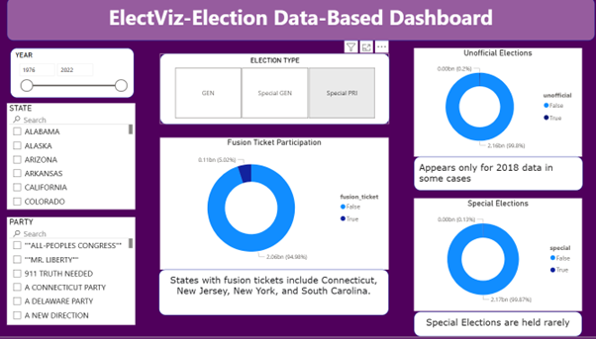

OUTCOMES

Slide 8
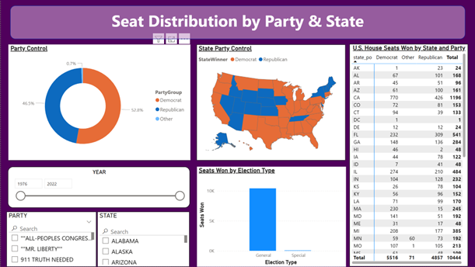


OUTCOMES

Slide 9
FUTURE ENHANCEMENTS
Predictive AI Integration: Incorporating machine learning models to project "Likely Winners" in real-time based on early partial returns.
Predictive "What-If" Modeling: Enabling a feature (similar to major news networks) to estimate final outcomes as soon as key precincts report.
Demographic Overlay: Integrating US Census data to visualize how factors like income, education, and age influenced the voting shifts seen in your current charts.
Live API Connectivity: Transitioning from static datasets to live Web API feeds (such as the Associated Press) for automated updates during election nights.

Slide 10
CONCLUSION
The project successfully transformed raw and complex election datasets into structured, accurate, and visually intuitive insights, enabling users to quickly interpret large volumes of electoral information that would otherwise be difficult to analyze in tabular form.
By leveraging modern data visualization techniques, the project clearly demonstrated how interactive dashboards can enhance the understanding of political trends, voting patterns, and long-term shifts in party dominance across multiple election cycles.
The dashboard enabled comprehensive and multi-dimensional analysis of party performance, voter behavior, seat distribution, and regional influence, allowing users to explore data at national, state, and candidate levels through dynamic filtering and drill-down capabilities.
Finally, the project established a strong and scalable foundation for advanced analytical work, making it well-suited for future enhancements such as real-time data integration, predictive analytics, demographic analysis, and more sophisticated decision-support systems.

Slide 11
ACKNOWLEDGEMENT
AND
REFERENCE
We would like to express our heartfelt gratitude to:
Infosys Springboard Team – for organizing this valuable internship opportunity.
Our Mentor – for her continuous support and feedback.
My Teammates – for collaboration, encouragement, and insights
This internship has been a significant step in our professional growth and technical journey.
References:
US_Election_Data(Kaggle source)
Microsoft Power BI Documentation
Infosys Springboard Virtual Internship course materials

Slide 12
THANK YOU

